Slide 1
Linear Regression: probabilistic view Linear Classification

Slide 2
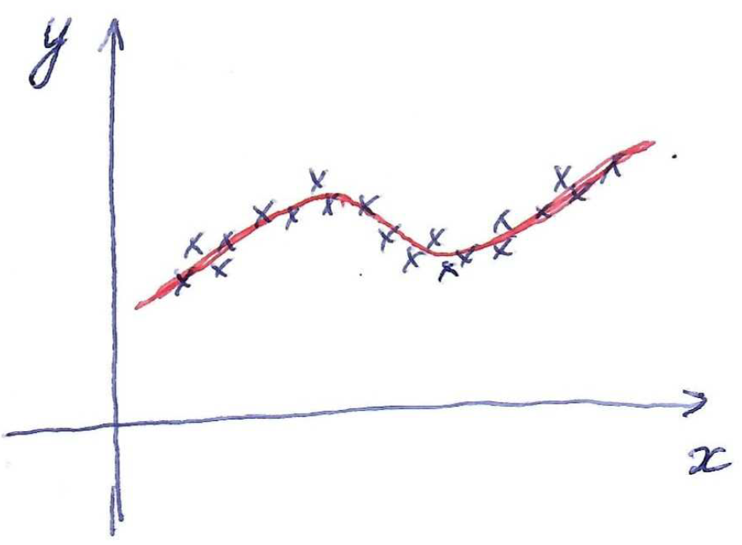
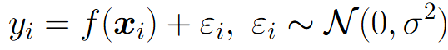
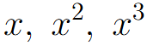
Linear regression
Good prediction model does not perfectly predict targets for training/testing objects (otherwise overfitting)
Let’s explain this inaccuracy with adding some random noise to prediction model:
Linear regression
with features
General idea: introduce some parametric probabilistic model of data generation, observe training data and find parameters of the model using e.g. maximum-likelihood estimation

Slide 3
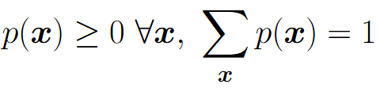
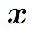
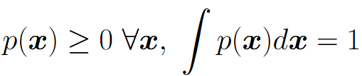
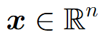
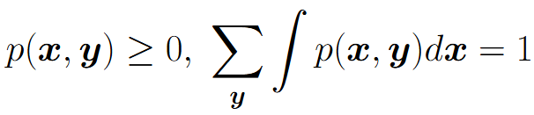
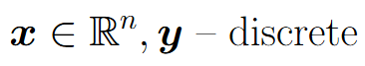
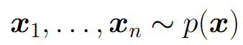
Probability distributions
Discrete variable :
Continuous variable :
Joint discrete-continuous case:
Basic operation - sampling from distribution:

Slide 4
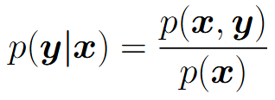
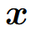
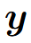
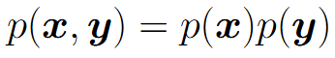
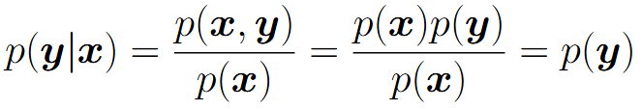
Conditional probability
In ML we’re interested in predicting one variable given another one. Hence conditional probability is useful:
Variables and are called independent if
For independent variables:

Slide 5
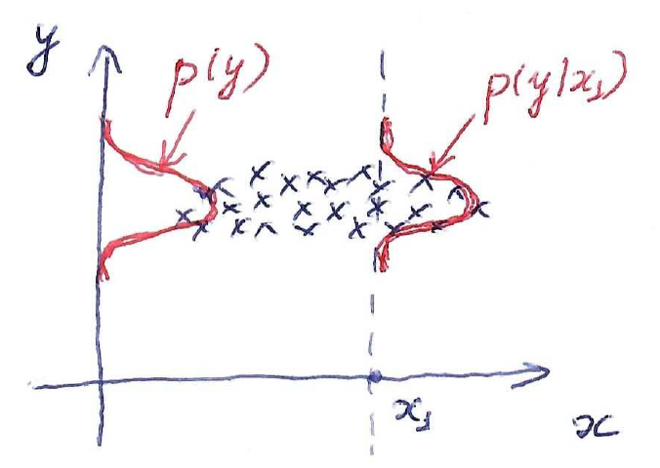
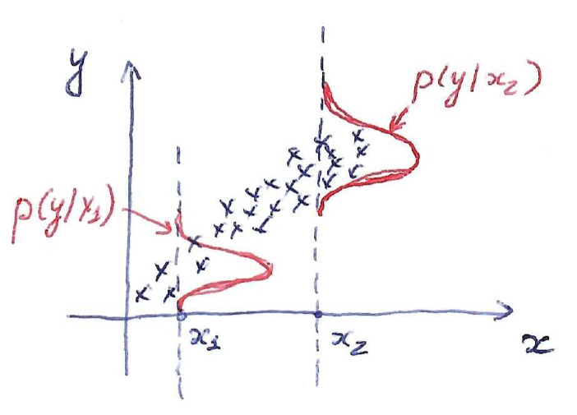
Conditional probability
Independent variables
Dependent variables

Slide 6
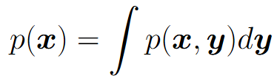
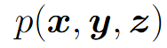
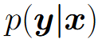
Operations with probabilities
Two basic operations: sum rule and product rule
Sum rule:
Product rule:
These two rules are enough to get from joint distribution to arbitrary marginal or conditional on subset of variables
Example: given find

Slide 7
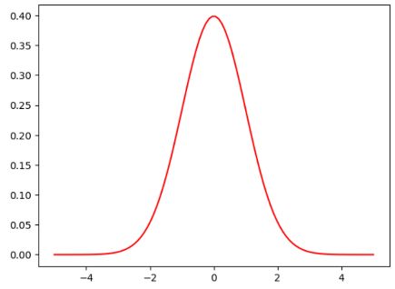
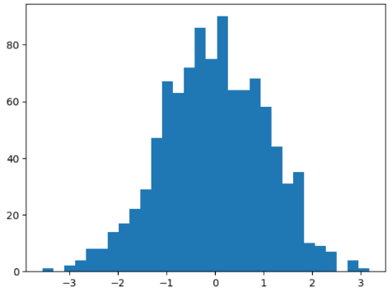
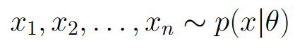
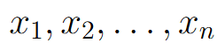


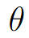
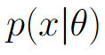
Distribution parameters estimation
Forward process: given probability distribution sample a set of points
Backward (estimation) process: given a set of points (data) estimate distribution parameters
Parameters of the prob. model

Slide 8
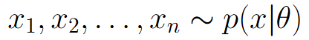
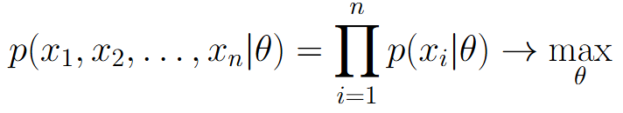
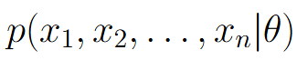
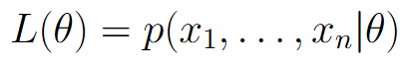
Maximum likelihood estimation
Suppose we have a set of points independently sampled from some parametric family of distributions
Goal: estimate parameters
Maximum likelihood estimation:
Terminology:
- as a function of x joint prob. distribution
- as a function of likelihood function
ML estimate has good theoretical properties for large n
(unbiased, consistent, efficient)

Slide 9
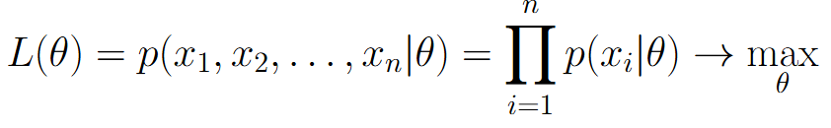
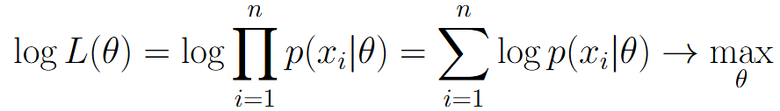
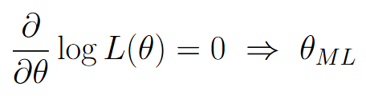
Maximum likelihood estimation
Maximum likelihood estimation:
Equivalent formulation:
Analytical solution:

Slide 10
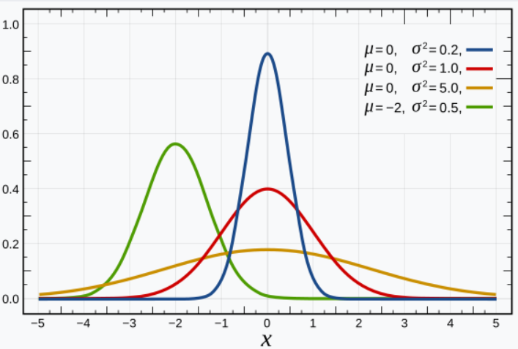
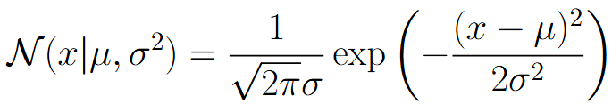
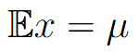
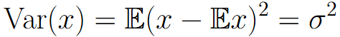
Normal distribution
Probability density function:
Statistics:

Slide 11
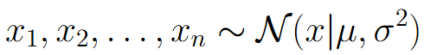
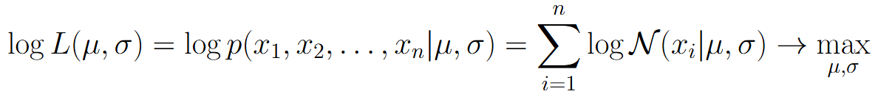
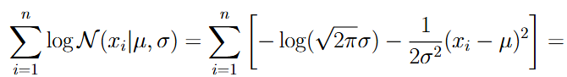
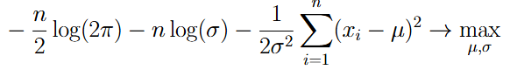
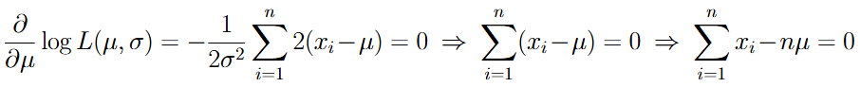
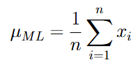
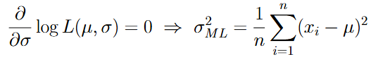
ML estimate for normal distribution

Slide 12
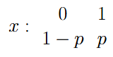
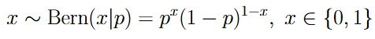
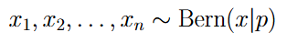
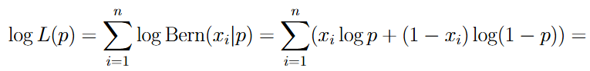
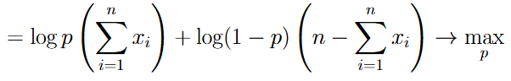
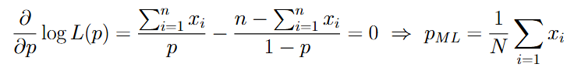
ML estimate for Bernoulli distribution

Slide 13









Linear Regression
Dataset:
ML-estimate for the model with normal noise = MSE loss minimization

Slide 14



Linear Regression
L1 loss

Slide 15





Linear Regression
Laplace distribution:
This optimization problem is equivalent to:

Slide 16
Linear Classification

Slide 17




Linear classification
Let’s consider two-class classification problem

Slide 18



Linear classification
Mean error rate
Regression
Classification

Slide 19



Linear classification
Mean error rate
Margin corresponds to distance from object to hyperplane = classifier confidence in prediction

Slide 20




Classification losses

Slide 21

Measuring classification quality
Accuracy is a reasonable metric for balanced classes in both training and testing set
Suppose we have some silly covid test that always says “person is healthy”. In dataset we have 950 healthy people and 50 sick people. Our covid test has 95% accuracy!

Slide 22
Measuring classification quality
Suppose we have two ML models for bank loans approval (scoring models). The first model approves 100 loans, among which 80 were returned and 20 were not returned. The second model approves 50 loans, among which 48 were returned and 2 were not returned. Which model is better?

Slide 23



Measuring classification quality
Confusion matrix
TP = True Positive
FP = False Positive
FN = False Negative
TN = True Negative
- How we can trust model in case of giving positive result
- How the model covers the positive class

Slide 24



Measuring classification quality
We need somehow combine precision and recall in one scalar criteria

Slide 25



Measuring classification quality
We need somehow combine precision and recall in one scalar criteria

Slide 26







Measuring classification quality
We need somehow combine precision and recall in one scalar criteria
If , then concentrates more on precision
If , then concentrates more on recall

Slide 27


Measuring classification quality
We need somehow combine precision and recall in one scalar criteria

Slide 28


Changing precision/recall balance for particular linear classifier
High precision
Low recall
High recall
Low precision

Slide 29
Changing precision/recall balance for particular linear classifier
For fixed dataset we have only one linear classifier, that is determined by solution of the following optimization problem:
How can we get a classifier with different precision/recall characteristics?

Slide 30


Changing precision/recall balance for particular linear classifier
Let’s introduce some threshold in decision rule:
Let’s sort all objects in training set w.r.t. its score value:
High threshold corresponds to high precision and low recall
Low threshold corresponds to high recall and low precision

Slide 31






Measuring classification quality for all thresholds
We have introduced a family of classifiers:
How to characterize their quality for all thresholds simultaneously?

Slide 32


Precision-Recall Curve for ideal classifier
AUC-PRC = Area Under Precision-Recall Curve

Slide 33




Receiver-Operating Characteristics (ROC)
False Positive Rate
True Positive Rate

Slide 34




ROC for ideal and random classifiers
Ideal classifier:
Random classifier:
Ideal classifier
Random classifier
AUC-ROC = Area Under ROC Curve

Slide 35

Gini index
Gini index = 2 * AUC-ROC - 1
Gini index equals approximately 0 for random classifier and equals 1 for ideal classifier

Slide 36









AUC-PRC vs AUC-ROC
ROC is monotonic and always starts at (0,0) and ends at (1,1)
PRC is non-monotonic, starts at (0,1) and ends at point that depends on training set
Value of AUC-PRC is less sensitive to the case of unbalanced classes

